Slide 1

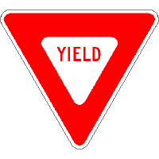


Module 3.3
Montana Teen Driver Education and Training
Mixing with Traffic

Slide 2
Essential Questions for
Mixing With Traffic
What are my responsibilities?
What are the responsibilities of others?
Do I know what I am capable of doing?
Can I predict what other drivers might do?
Do I know how to legally and respectfully share the road with other drivers?
Notes:
Every driving situation can be addressed with the following set of questions. While going through this presentation, have these questions in mind. Have the student refer back to their Mixing with Traffic fact sheet for these questions when working through the slides.

Slide 3
Getting Ready
Working in groups of three or four, identify 3 ways you will mix with traffic when you start driving.
  An example: I will use my turn signals to let others know my intentions. If I don’t, then …
  Another: I will yield the right of way at an intersection. If I don’t, then …
  And: I will not speed up to beat a train at a railroad crossing. If I do, then …
Notes:
The purpose of this module is to get students thinking about how they should legally interact with other highway transportation users. This activity gets the students thinking about what they have seen with other drivers and what the potential conflicts might be if they failed to follow the law while driving.
Other examples:
What if I changed lanes without looking?
If I didn’t stop at a stop sign what would happen?

Slide 4
RIGHT OF WAY
ROW Must be Given, Not Taken
Failure to yield right of way causes approximately 20 percent of all collisions in Montana
Who must yield when:
One vehicle arrives first?
Two vehicles arrive at the same time?
Notes:
Most students believe that when the law says they have the right of way that they can take it with impunity. Thinking in terms of giving right of way versus assuming and taking right of way. This will protect them from crashes when they are mixing with traffic. There used to be a commercial that stated you may be right but you don’t want to be dead right. Even though I have the right of way I can’t always be certain that the other users know who has right of way and who must yield.

Slide 5
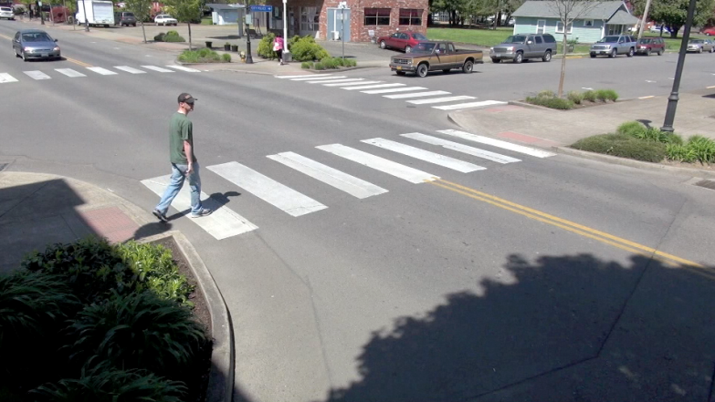
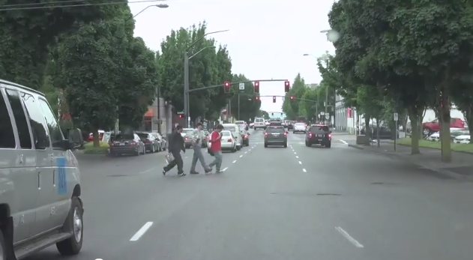
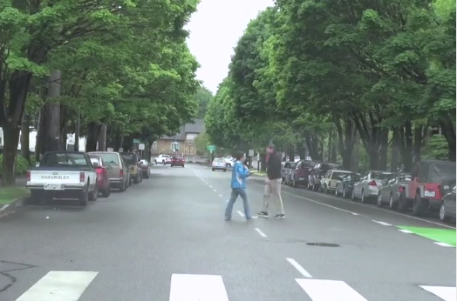
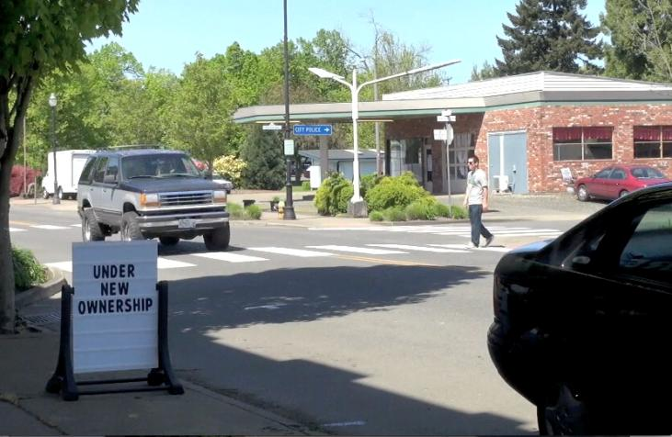
Pedestrians
What are the right-of-way laws (ROW) for these pedestrians?
Notes:
What are your responsibilities when mixing with these pedestrians? What should you do while waiting for them to cross?

Slide 6
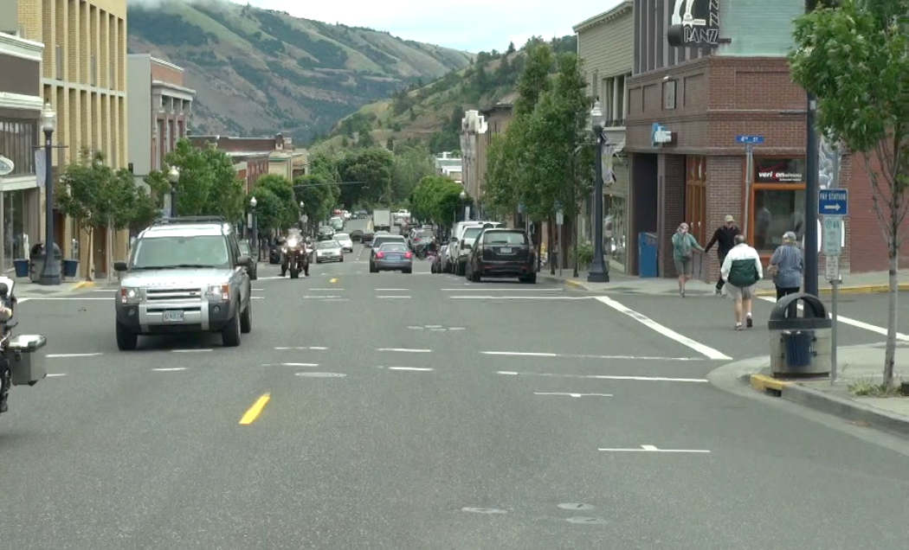
You intend to turn right at the next intersection.
Describe the scene and explain what you need to do.
Montana laws help us safely interact with others.
What law applies here?
Notes:
The law requires that you wait for the pedestrians to cross before you make your right turn. Since pedestrians are crossing from both directions you will have to wait until all have finished crossing.
For more information look at Module 3.3 ROW Factsheet.

Slide 7
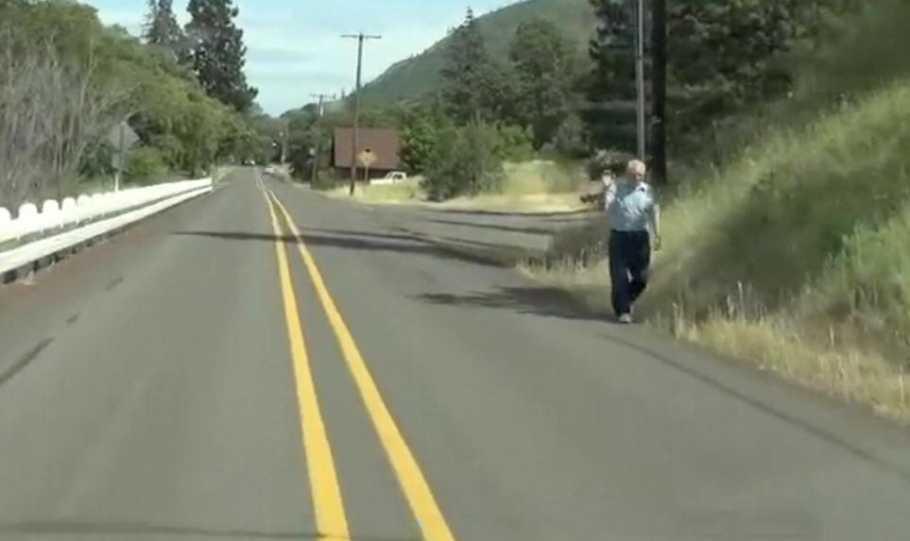
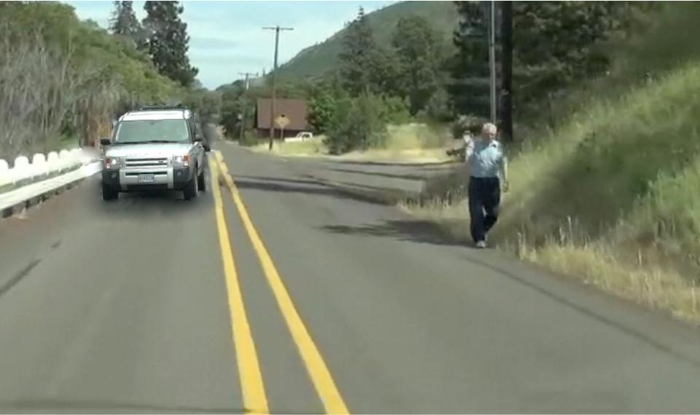
How do we share the right of way with this pedestrian?
With the addition of this car, what right of way laws do I need to obey?
What do I need to do to share the road with each of these users?
Notes:
Click to initiate the animation.
Under what conditions can I cross the yellow lines to avoid hitting the pedestrian?
What must I do before I do that?
What do I need to do to create space or reduce risk when both the car and the pedestrian are there?

Slide 8
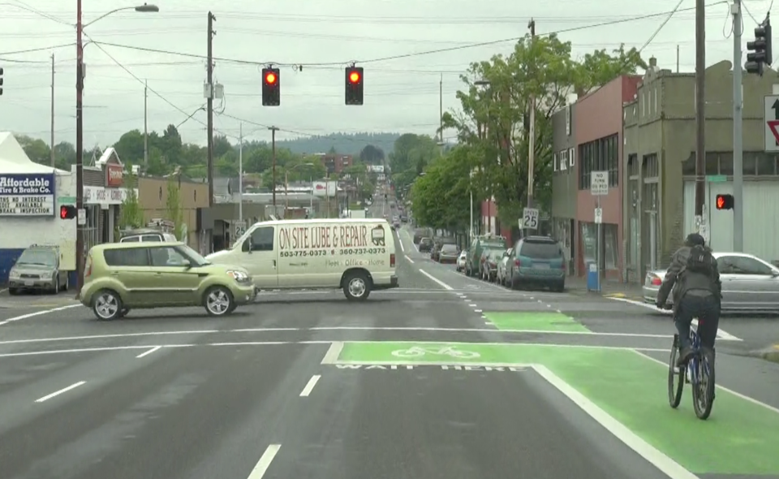
You intend to turn right.
Where should you check before you turn?
Since the light is red, where should you stop?
What Zone or Zones should you check?
Can you turn right after stopping at this red light?
Notes:
Bike boxes are relatively new. They provide space for drivers and cyclists in places where historically there has been conflict. The law requires that the motorist stop prior to entering the green painted area when the light is red. Then when the light turns green the driver must yield to cyclists when turning to ensure the cyclist’s safety.

Slide 9
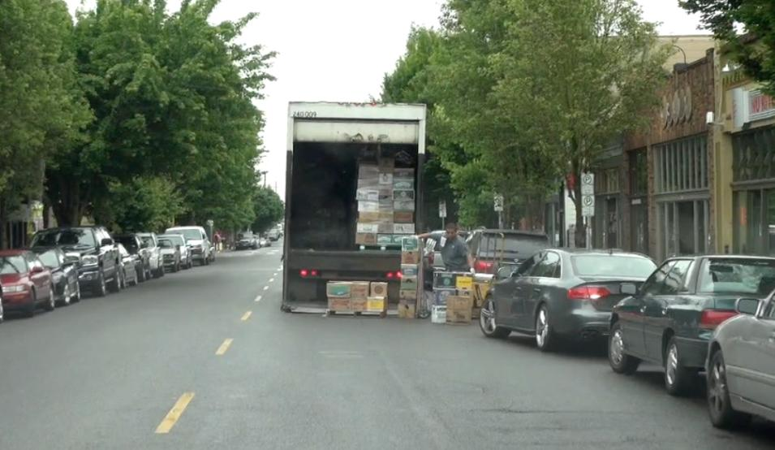
You need to pass this truck. What should you consider before you pull around it?
How is your line of sight?
If you choose to pass, who must yield to whom?
What other zones should you check before passing this truck?
Notes:
Double-parked trucks are common in urban environments but the principles are the same whether you are in the city or country. To pass this truck the questions on the slide must be dealt with so that the driver can safely mix with traffic.
Stop far enough back to get a clear line of sight around the truck.
Move to lane position 2 to increase your line of sight.
As you approach this truck you should check your rear zone, then check your left front zone, signal your intentions and move into the other lane to pass.
See the truck’s headlights in the mirror and return to your lane.

Slide 10
Intersections
Types of Intersections
  Uncontrolled
  Controlled
  Residential
  Roundabouts
Driver Responsibilities
  Remember essential questions
Notes:
Every intersection can be controlled or uncontrolled. Have the students identify what makes an intersection controlled or uncontrolled and then describe what they must do in each of the intersections. Essential questions help drivers understand their responsibilities at each intersection.

Slide 11
Student Activity 2: Looking for Clues
Working in groups of two or three answer the following questions:
  What are ways we know (cues or clues) that we are approaching an intersection?
  What is the difference between a controlled and an uncontrolled intersection?
  What signs or signals are used to control traffic at an intersection?
Notes:
As students work through this, remind them that they need to recognize that they are approaching an intersection, that there are clues to approaching intersections, that each intersection is controlled or uncontrolled and each has some clue to whether it is controlled or not, and that they need to manage their vehicle as they approach an intersection remembering that right-of-way laws apply.

Slide 12
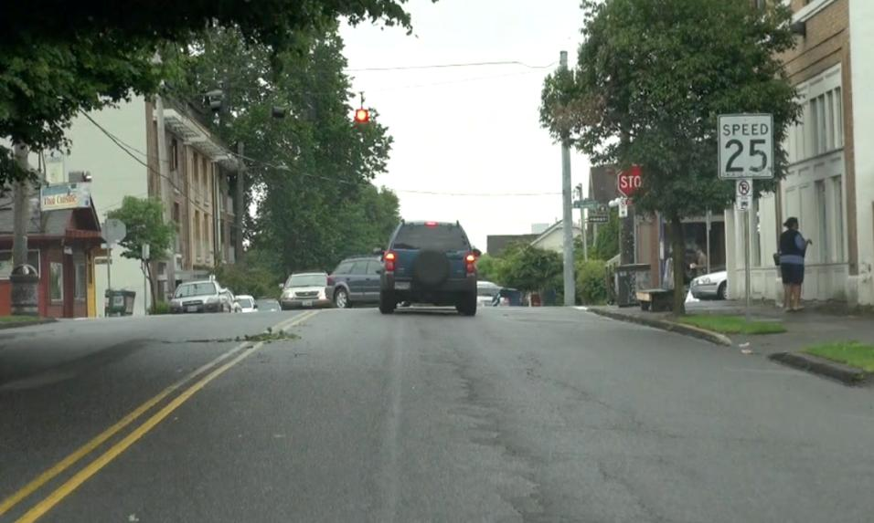
Intersections
Controlled or uncontrolled?
How do you know?
Where should you check when you approach this intersection?
Notes:
The next set of slides show some kind of representation as to how an intersection is controlled or not. The responsibility of the driver is to identify that 1. there is an intersection, 2. whether it is controlled or not, and 3. what their responsibilities are as they approach and travel through this intersection.

Slide 13
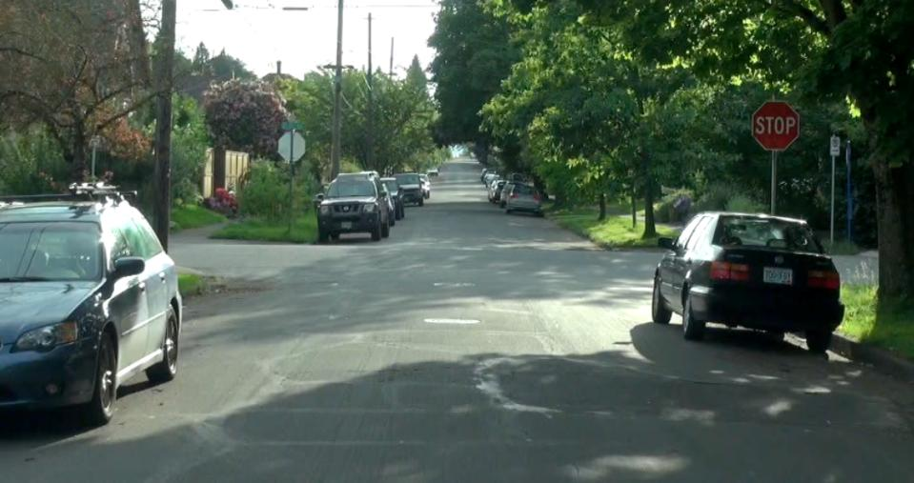
Cross traffic does not need to stop.
You intend to continue ahead.
What should you do and who must yield?
Where should you stop?
How should you search this intersection?
Notes:
They should stop at the pedestrian zone such as the crosswalk or implied crosswalk indicated by the sidewalks. They should search the intersection to the left, front, and right as they get ready to travel through the intersection. They will need to yield to the cross traffic since they do not need to stop and have no traffic control device telling them to stop.

Slide 14
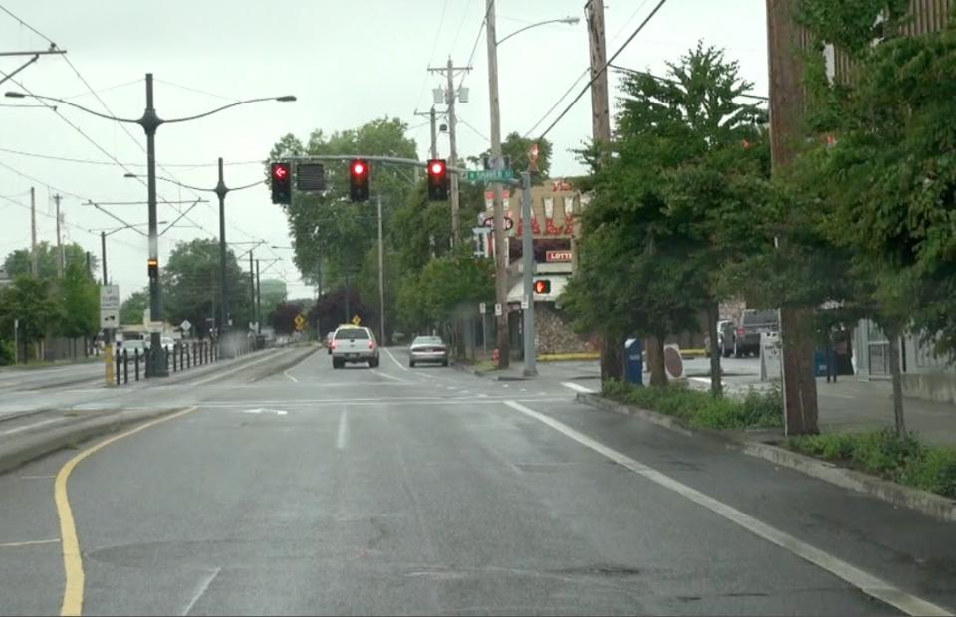
Controlled or uncontrolled?
How do you know?
Notes:
This is a controlled intersection and is indicated by the traffic light. Since it is red, they need to check their rear zone and stop at the stop line or cross walk. We know that it is a controlled intersection because of the traffic signal above the intersection.

Slide 15
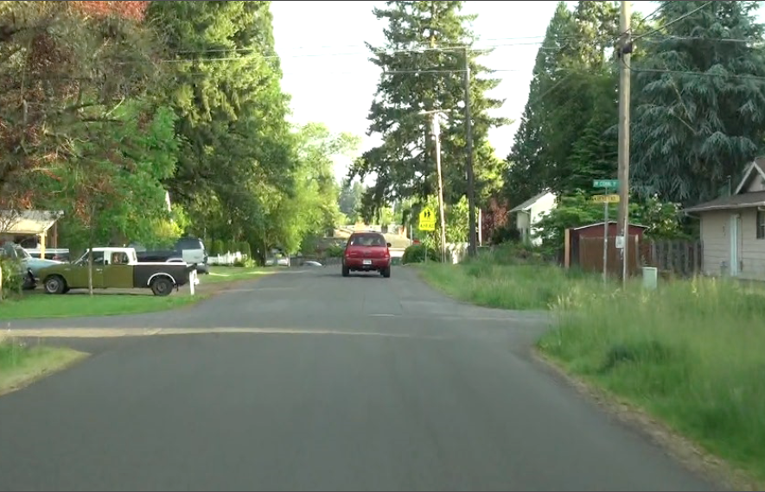
Controlled or uncontrolled?
How do you know?
Notes:
This is an uncontrolled intersection because the intersection has no stop or yield signs. The right-of-way laws apply and we would need to yield to cars approaching the intersection from the right.

Slide 16
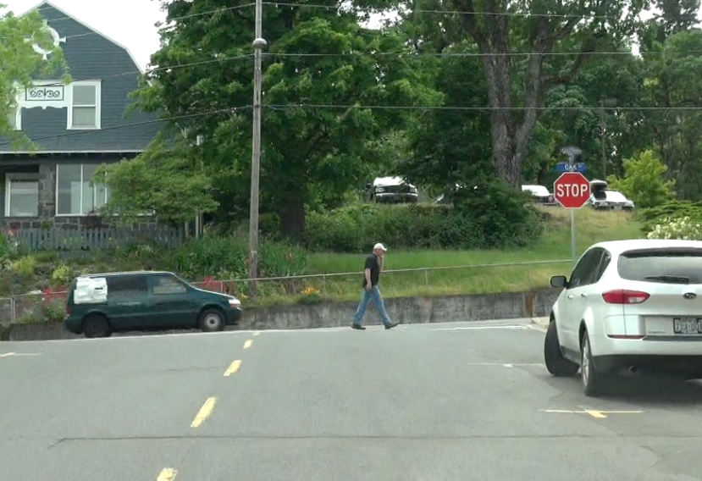
Controlled or uncontrolled?
How do you know?
Notes:
We know this is a controlled intersection because of the stop sign at the intersection.

Slide 17
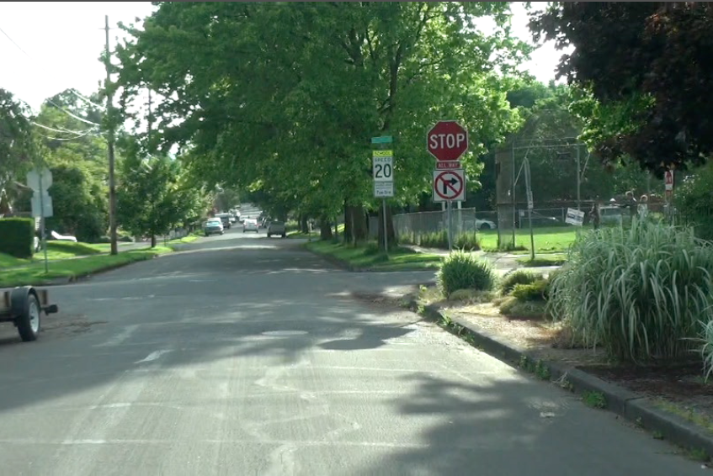
Controlled or uncontrolled?
How do you know?
What other action is prohibited?
Notes:
This is a controlled intersection because of the stop sign at the intersection. We also cannot turn right as indicated by the sign below the stop sign.

Slide 18
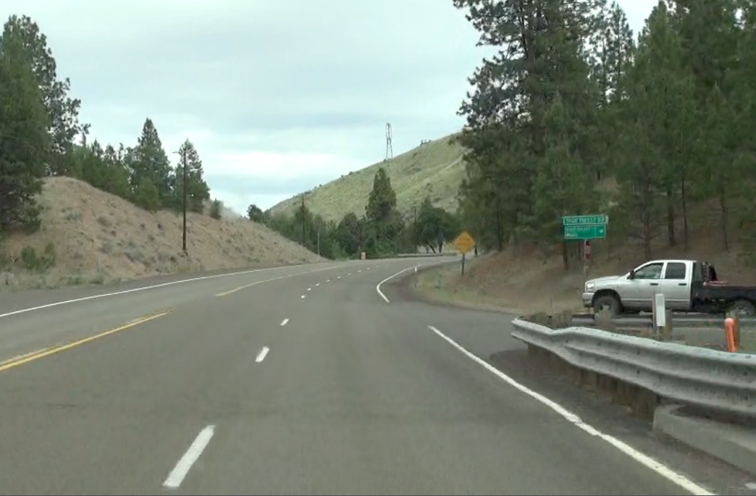
Controlled or uncontrolled?
How do you know?
What other zone should you check when approaching this situation?
Notes:
This is a controlled intersection because the truck on our right has a stop sign. We should check our rear and left rear zone because we may need to move to our left to either lane position 2 or even lane position 4 if the driver of the truck chooses to move into the intersection as we approach.

Slide 19
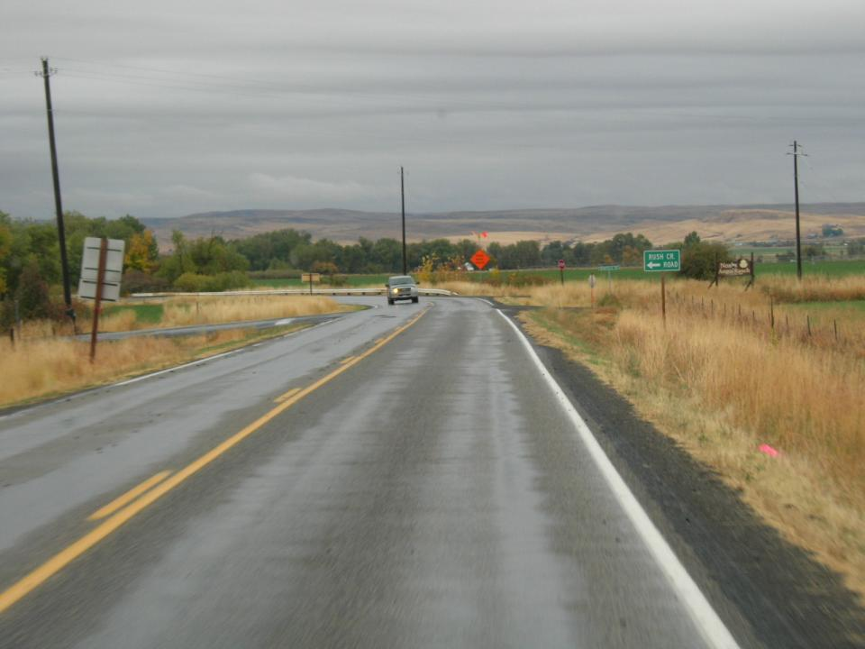
Controlled or uncontrolled?
How do you know?
What clues help you see the upcoming intersection?
What do you predict the oncoming car might do at this intersection?
Notes:
This is a controlled intersection indicated by the white line on the pavement of the crossroad. We may need to be prepared for the oncoming car getting ready to turn left in front of us. We should check our rear zone to ensure that we can stop safely in case the driver thinks they can turn in front of us.

Slide 20
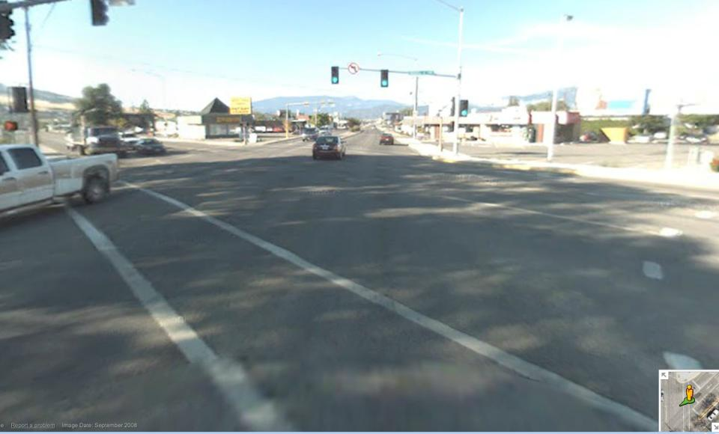
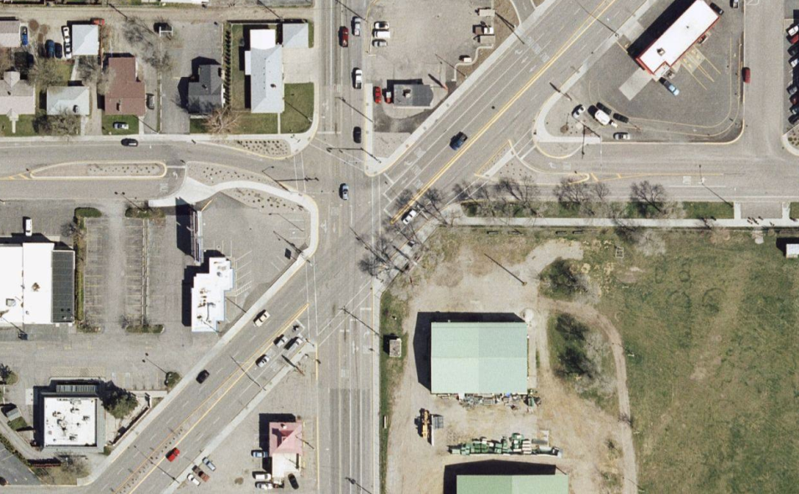
Now for a very complex intersection:
Missoula’s “Malfunction Junction”
You are looking from here in the next picture
Controlled or uncontrolled?
How do you know?
What other action is prohibited?
What makes this intersection so complex?
Notes:
Click through the animations.
This is a controlled intersection because of the traffic light at the intersection. We cannot turn left. This intersection is complex for several reasons. The first is the angle of the roads crossing at this intersection. The second is there are multiple lanes going in both directions. The third is that there are more than two lanes crossing into this intersection.

Slide 21
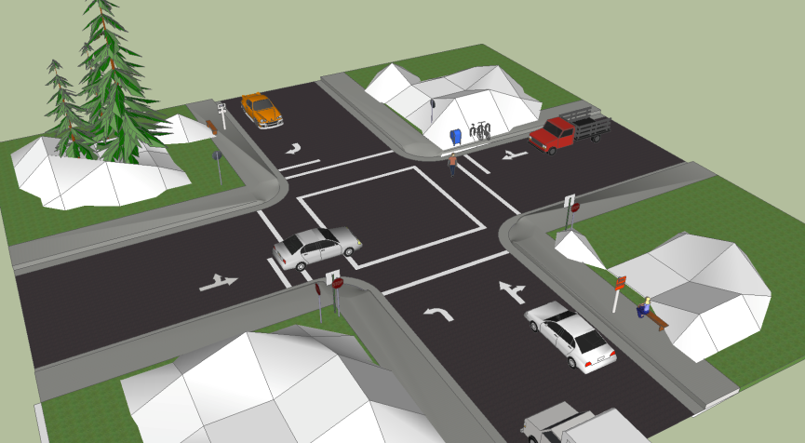
Use the following diagram to answer the next series of questions.
What is the gold car’s only option?
Does it need to stop first? How do you know?
What can the red truck do?
Who must he yield to?
The driver of the white car wants to turn right. Explain the steps she should take to safely complete her turn.
The silver car is going straight. Whom should he yield to? Why?
Notes:
Click through the animations.
This slide can help students understand the complexities of intersections and the need to look at pavement markings, signs and cross traffic to know how traffic is going to move through an intersection.
Have students work in groups of two or three to answer the questions presented on the slide. Then share their responses with the rest of the class.

Slide 22
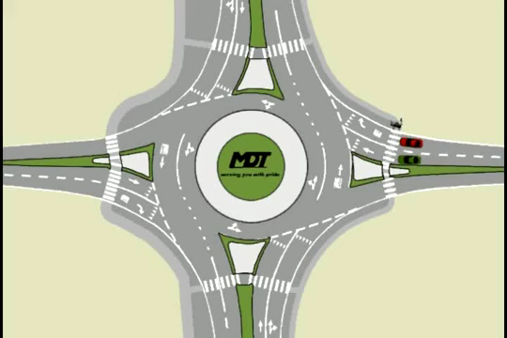
Roundabout Intersection
Rule of Thumb for Roundabouts:
Yield on Entrance,
Signal on Exit
PLAY VIDEO (:29)
Notes:
This animation shows a pedestrian and how the blue, green and red cars will proceed through this intersection. Discuss the following scenarios:
Describe the actions the red car must do before making a right turn.
The blue car will enter from the bottom of the traffic circle. Since it is in the roundabout first what must the other cars do?
Can the red car make the right turn when in front of the blue car? Why or why not?
The green car wants to make essentially a left turn and exit the round about at the bottom of the slide. Describe what he must do with the pedestrian and with the blue car entering from the bottom.
Why must the red and green car wait for the blue car to pass before they enter the round about?

Slide 23
Lane Changes
See the Need
See the Space
Check the Time
Why do I need to change lanes?
Scan and search. Do I have the space to change lanes?
Do I have enough time to change lanes safely?
Notes:
Some driver educators have described lane changes as one of the most difficult and high risk maneuvers a driver will make. Ask the students why they think this might be.
There are three things a driver must do prior to making a lane change:
See the need
See the space
Check the time available to make the lane change.
If a driver can’t provide an adequate response to the above requirements then they shouldn’t make the lane change.

Slide 24
Group Activity 3:
Reasons for Changing Lanes
(2 minutes)
  Identify 5 reasons you might need to change lanes.
  Identify 3 reasons you would delay making a lane change.
  Identify 2 reasons you would “abort” a lane change.
  Ready? GO!
Notes:
Click through the statements and then have the students work in groups of two or three and answer the statements. Give them only two minutes so they will stay on task and work through their answers.

Slide 25
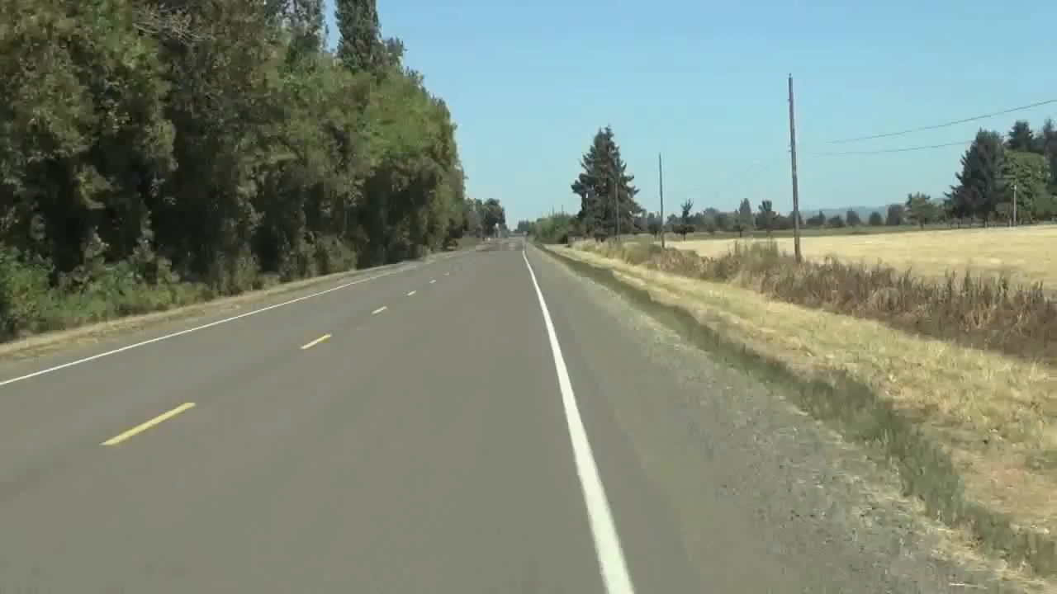
Reasons for Changing Lanes
PLAY VIDEO (:19)
Notes:
Have students watch this video to see if their answers to the previous slide were complete or if they need to add more reasons for changing lanes.

Slide 26
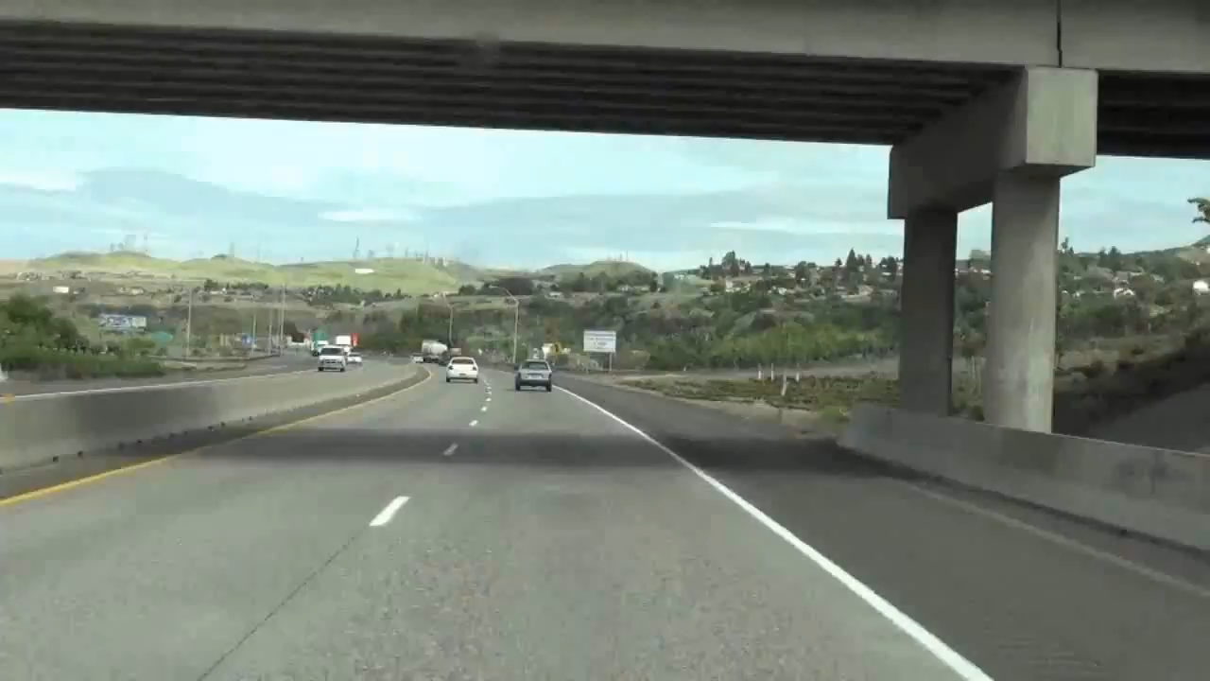
Reasons for Changing Freeway Lanes
PLAY VIDEO (1:11)
Notes:
This video shows how to make a lane change when passing on the freeway. It uses videography to show approaching a car, what to do and where to look before, during and after the lane change. Notice the three mirrors in the video. The driver could continue in the left lane to pass the truck, but moves into the right lane after passing the Subaru because his exit is coming up and he needs to get back to the right to take the exit.

Slide 27
Reasons for Changing Lanes
Before initiating the passing maneuver, ask:
  What will be gained by passing?
  What are the risks?
  Is the pass legal?
  Will the traffic ahead present additional risks if a pass is attempted?
  Will the traffic ahead be essentially the same if the pass isn’t made?
  Will there be a better, safer opportunity to pass later, for instance, a passing lane?
Notes:
Each one of these questions needs to be asked before initiating and completing a pass of another vehicle when on a two-way road. This is a great place to have a discussion on the risks and benefits of passing and whether they will gain enough to risk making a pass.

Slide 28
Classroom Activity:
Passing Safely
Use “Estimate Passing Gap Requirements” Factsheet
Watch video on next slide and discuss.
Notes:
• Before initiating the passing maneuver, ask:
What will be gained by passing?
Will the traffic ahead present additional risks if a pass is attempted?
Will the pass result in even more passing maneuvers to “get ahead?”
Will the traffic ahead be essentially the same if the pass isn’t made?
Will there be a better, safer opportunity to pass later? Perhaps a passing lane coming up?
What are the risks?
Is the pass legal?
A driver traveling 40 mph, passing a vehicle traveling 30 mph, starting the pass at the 2-second following distance will need about 13 seconds to complete the pass
At 50 mph about 16 seconds will be needed
At 60 mph about 19 seconds will be needed
• If oncoming traffic is traveling at 60 mph, the combined distance needed to pass at 60mph is 38 seconds, or 3,344 feet (two-thirds of a mile)!

Slide 29
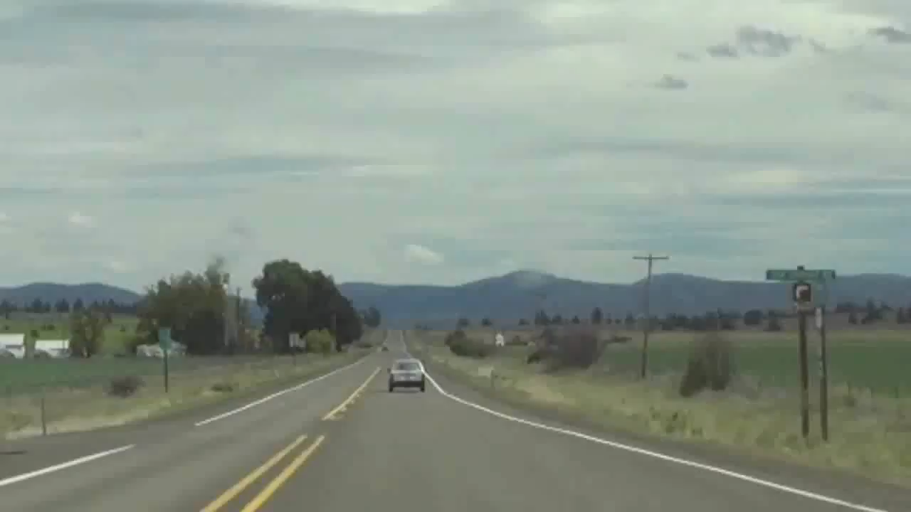
Passing Safely
PLAY VIDEO (:26)

Slide 30
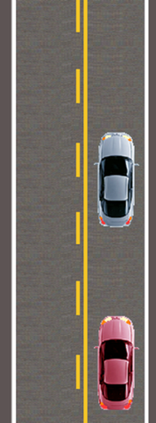
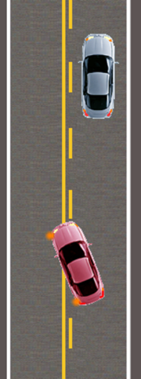
Passing and Being Passed
Why is passing permitted in the right diagram but not in the left diagram?
Notes:
When you are being passed, what is the courteous thing to do?

Slide 31
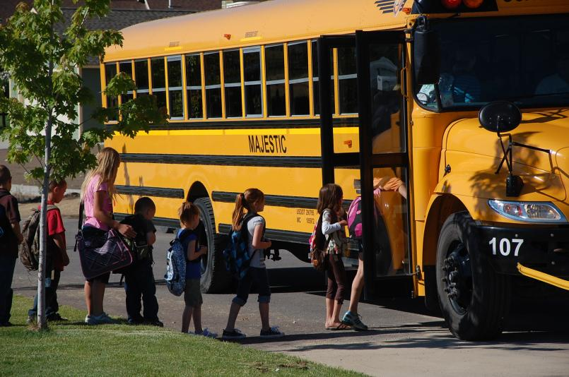
When can you pass a school bus?
Notes:
Drivers must STOP when school buses flash red lights.
Upon meeting or overtaking from either direction any school bus stopped with its red lights flashing, the driver of a vehicle must stop before reaching the bus and shall not proceed until the red lights have been extinguished.
As a driver, you do not need to stop if meeting or passing a school bus that is on a different roadway or the bus is stopped in an adjacent loading zone where pedestrians are not permitted to cross the roadway.

Slide 32
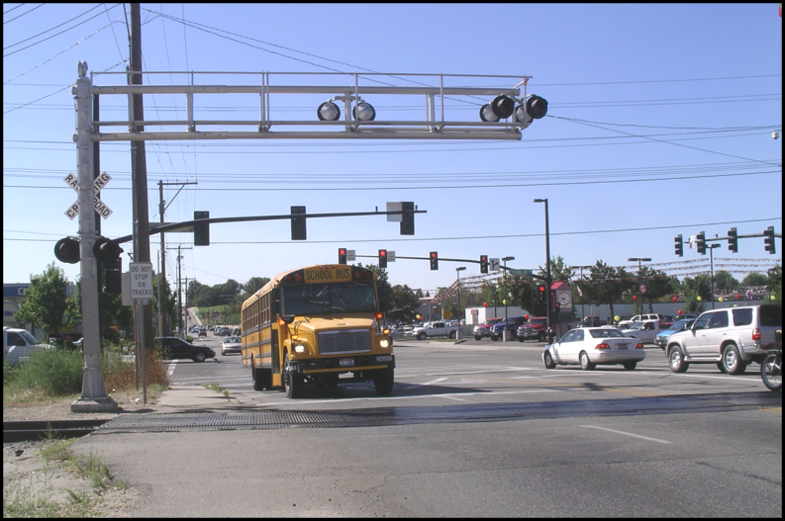
Why are the school bus lights flashing?
Notes:
School bus requirements include stopping at all railroad crossings according to MCA 61-8-349.

Slide 33
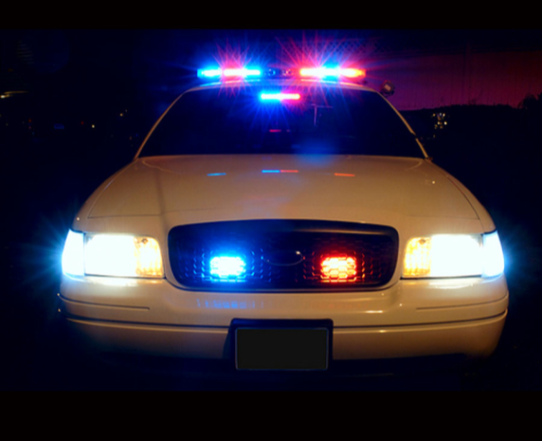
Emergency Vehicles
You look in your rear view mirror and see this.
What are you supposed to do?
Explain how you re-enter traffic once the officer has passed.
Explain what you should do if she pulls in behind you after you stop.
Notes:
Use the questions on the slide to engage the class in a discussion. This is a great opportunity to talk about traffic stops and what a driver should do if they get pulled over to minimize the risk of conflict between the officer and the driver.
Traffic Stop 2 is a video in the Extra Resources folder showing a typical traffic stop for a burned out tail light.

Slide 34
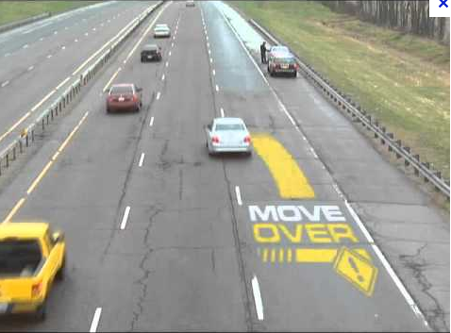
Move Over Law
Think back to Strategies for Vision and Scanning
I can only move over if I see the stopped emergency vehicle in the first place.
The law requires that I move over
to the next lane before I reach the
emergency vehicle parked on the
side of the road.
If I can’t, then I slow down to
allow time to respond safely.
Notes:
Class discussion:
Why is it a good idea to move over to the next lane should you see a stopped emergency vehicle ahead?
Remember this in terms of the Vehicle Control Sequence:
seeing the need to move
checking the other lanes to make sure I have enough time and space to move over
then executing the lane change in a safe and timely manner

Slide 35
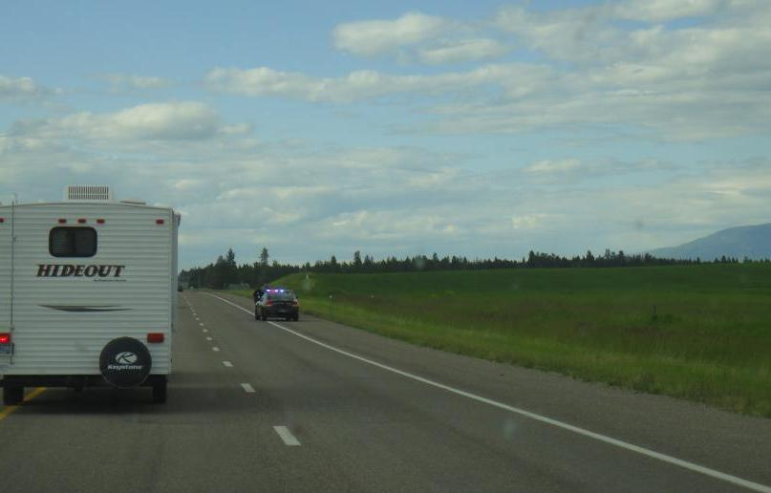
Emergency Vehicles
Notes:
The Move Over law requires vehicles to move over into the left lane to pass a parked emergency vehicle ahead.

Slide 36
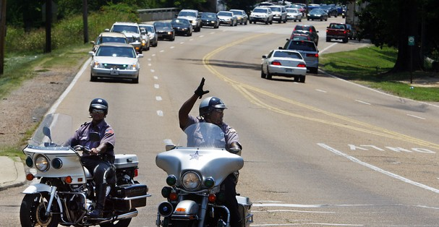
Funeral Processions
Notes:
A funeral procession has the right of way and can disobey traffic control devices if they are part of the procession and have assistance from police or security personnel.
Do NOT join the procession to get through the lights and stop signs.
Do NOT pass the procession to try to get ahead.
Respect the deceased and the mourners as they proceed to the funeral and cemetery.

Slide 37
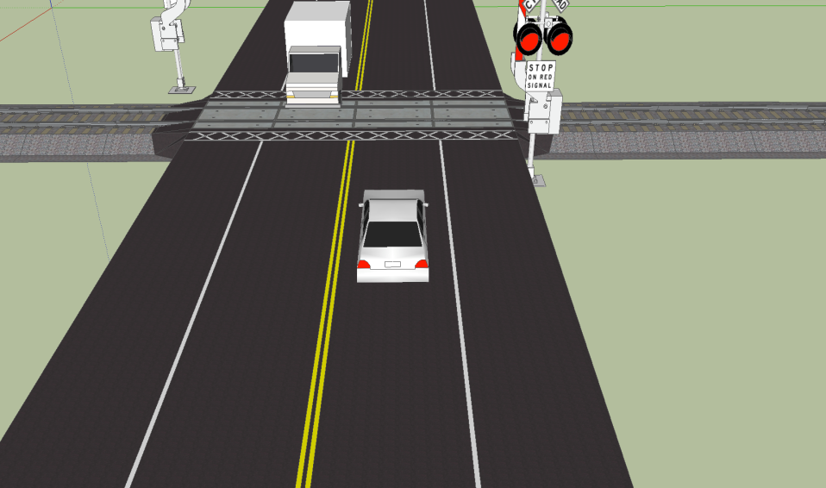
Rail Grade Crossings
The total number of rail grade crossings in Montana:
Public Crossings: 1491
Private Crossings: 2007
Pedestrian Crossings: 15
Total Crossings: 3513
Notes:
Students need to understand the unique qualities of a rail grade crossing and the problems they present to trains and to drivers. Always expect a train!

Slide 38
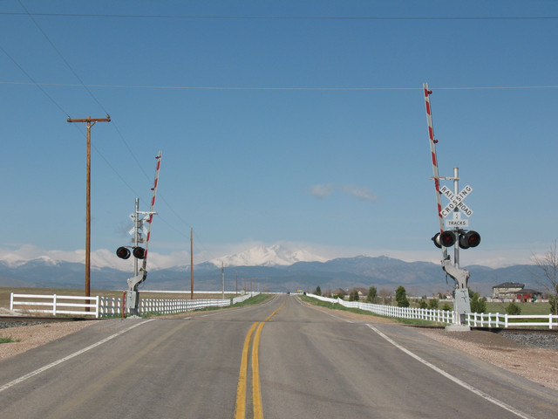
Is it legal to pass here?
How do you know?
How many tracks are at this crossing?
Do you need to search this intersection before you cross?
Notes:
Notice the double yellow lines approaching the crossing. It is illegal to pass another vehicle at a crossing. Why do you think that is? Even though the crossing has gates and signals it is a good idea to search upon approach to a crossing since they have been known to fail on occasion.
Remember that a train cannot stop as quickly as you can. It is estimated that it takes a train 1 mile to stop when it is moving at 60 MPH and fully loaded.

Slide 39
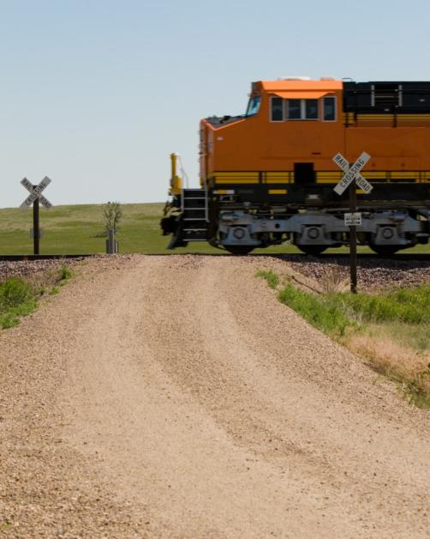
Who yields at this RR crossing?
What kind of signage does this crossing have?
What speed should you approach and cross this crossing?
Describe the searching process as you approach this crossing.
Notes:
Have the students describe what is unique about this intersection and why they should approach this intersection with more caution.
Roadway—Gravel
One Lane
Elevated Track
No Signal or Crossing Arms
Can’t see the other side of the tracks and condition of the roadway
Potential to high center a longer vehicle or trailer

Slide 40
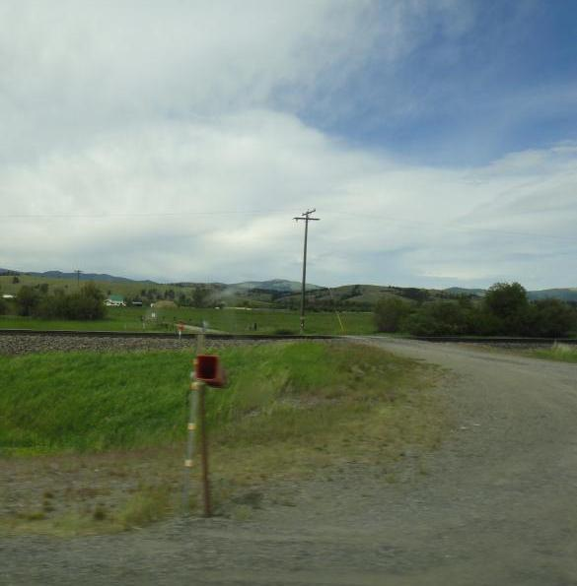
What is unique about this intersection?
What precautions should you take when approaching and crossing this intersection?
What are some drivers tempted to do when approaching this intersection?
Notes:
There are many rail grade crossings similar to this in rural parts of Montana, Idaho, North Dakota and Wyoming. People develop the habit of crossing without looking and increase their risk of a crash because they don’t exercise greater caution at this crossing.

Slide 41
Montana Driver Education and Training
Standards and Benchmarks
1. Laws and Highway System
  1.1. know the laws outlined in the Montana Driver's manual;
  1.2. understand the laws outlined in the Montana Driver's Manual; and
  1.3. consistently demonstrate knowledge and understanding by responsible adherence to highway transportation system traffic laws and control devices.
2. Responsibility
  2.1. recognize the importance of making safe and responsible decisions for owning and operating a motor vehicle;
  2.2 demonstrate the ability to make appropriate decisions while operating a motor vehicle;
  2.3. consistently display respect for other users of the highway transportation system; and
  2.4. develop positive habits and attitudes for responsible driving.
3. Visual Skills
  3.1. know proper visual skills for operating a motor vehicle;
  3.2. communicate and explain proper visual skills for operating a motor vehicle;
  3.3. demonstrate the use of proper visual skills for operating a motor vehicle; and
  3.4. develop habits and attitudes with regard to proper visual skills.
4. Vehicle Control
  4.1. demonstrate smooth, safe and efficient operation of a motor vehicle; and
  4.2. develop positive habits and attitudes relative to safe, efficient and smooth vehicle operation.
5. Communication
  5.1. consistently communicate driving intentions (i.e., use of lights, vehicle position, and personal signals);
  5.2. adjust driver behavior based on observation of the highway transportation system and other roadway users;
  5.3. adjust communication (i.e., use of lights, vehicle position, and personal signals) based on observation of the highway transportation system and other users; and
  5.4. develop positive habits and attitudes for effective communication.
6. Risk Management
  6.1. understand driver risk-management principles;
  6.2. demonstrate driver risk-management strategies; and
  6.3. develop positive habits and attitudes for effective driver risk-management.
7. Lifelong Learning
  7.1. identify and use a range of learning strategies required to acquire or retain knowledge, positive driving habits, and driving skills for lifelong learning;
  7.2. establish learning goals that are based on an understanding of one’s own current and future learning needs; and
  7.3. demonstrate knowledge and ability to make informed decisions required for positive driving habits, effective performance, and adaptation to change.
8. Driving Experience
  8.1. acquire at least the minimum number of BTW hours over at least the minimum number of days, as required by law, with a Montana-approved driver education teacher; and
  8.2. acquire additional behind-the-wheel driving experience with a parent or guardian’s assistance in a variety of driving situations (i.e., night, adverse weather, gravel road, etc.).
Notes:
Standards and Benchmarks: This is for your reference and not to be read to the class verbatim. Please review prior to the lesson so you are aware of what the student will be required to know at the end of the module.

